Slide 1


ELEC 535 :Data Analysis and Pattern Recognition
A Critical Review on Detection of Structurally Anomalous Logins within Enterprise Networks
By
Derrell D’Souza

Slide 2
Introduction
Problem
Credential based Lateral Movement(CLM)
Stealing credentials and compromising computers to reach the target destination.
Cannot be detected by NIDS due to no changes in the network traffic as compared to the normal login.
Lateral movements cannot be minimized due to relaxed access control in business environments

Slide 3
Introduction
Solution
Network Login Structure
Characterization of Normal Login Structure
First -model the Network Login Structure by extracting Login patterns
Second -detecting anomalous patterns by identifying patterns that are inconsistent with the structure.

Slide 4
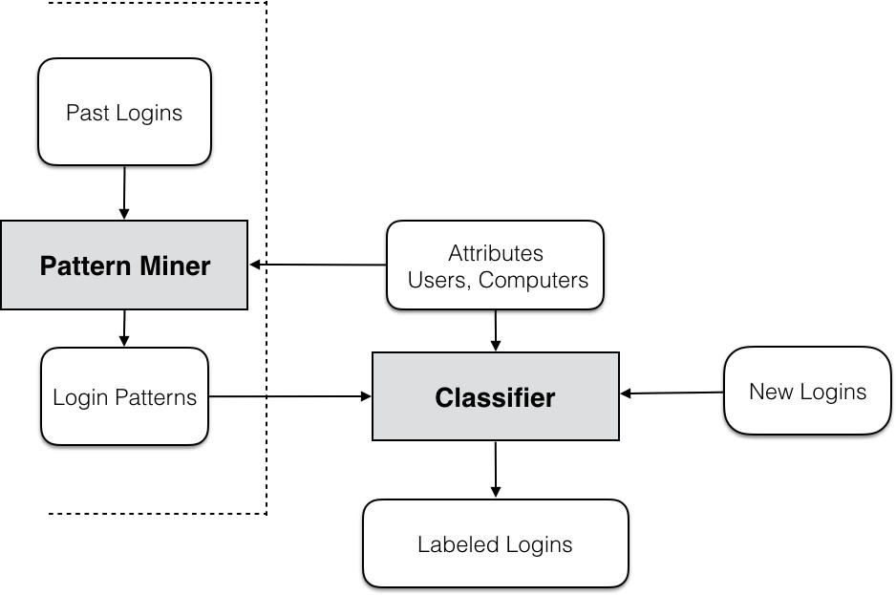
Materials and Methodology
Pattern Mining Algorithm
Semi supervised Binary Classifier

Slide 5
Materials and Methodology
Pattern Miner
Mines the normal login patterns from past logins.
The login pattern is stated to be composed of three components
Login l is defined as l = <u, s, d> u-user, s-source computer, d-destination computer.
Login history is H . Login attributes are U,S and D and pattern P = <U’,S’,D’>.
A login l = <u, s, d> with attributes A = <U, S, D> is an occurrence of pattern P = <U’, S’, D’> if U’ ⊂ U, S’ ⊂ S and D’ ⊂ D.

Slide 6
Materials and Methodology
Pattern Mining Algorithm
Enumeration
Enumerates candidate patterns from Login history H
first generating power sets of each based on attribute of elements of login namely- U*, S* and D* and then taking the Cartesian product U*× S* × D* that generates all the candidate patterns.
Generation of Orientation scores
Patterns are grouped and their orientation scores are calculated to decide if source orientated , destination orientated , user oriented by U-score, D-score and S-score respectively.
Algorithm selects pattern with orientation scores above a specific threshold.

Slide 7
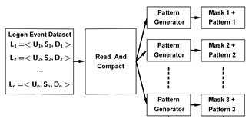
Materials and Methodology
Pattern Mining Algorithm
Encoding and Parallelization

Slide 8
Materials and Methodology
Login Classifier
Exact Matching
In exact matching, a login l =< u, s, d > is classified as benign if there is a login l ′ =< u ′, s ′, d ′ > in the login history H, where u = u ′, s = s ′, and d = d ′. Otherwise, it classifies the login as malicious.
Pattern Matching
Output of the pattern mining i.e. the network login structure is compared with new login and if the pattern matches than it is benign.
A confidence score is calculated for each pattern that doesn’t exactly match with the past benign login but matches the normal login pattern. Orientation scores of the pattern is be used as a confidence of matching the current login with normal login.

Slide 9
Analysis and Implications
The model is designed only for CLM based attacks
The paper claims that there is always inconsistency associated with the login structure because the attacker can use only the available stolen credentials and the compromised computers to move laterally in the network.
However this is not the case every time. If attacker knows the login structure, it might create problems however he must have the right credentials which is not often the case.
The solution is to exclude infrequent logins from the login history H.
Chances of false positives are high if the network dynamics change and network login structure cannot work if the frequency of update of network structure will not be able to match the network dynamics.
This method is redundant for unstructured network.

Slide 10
Analysis and Implications
Statistics
System was evaluation using real data set from a single company.
Logins are either windows network login or remote interactive login.
Login includes data count and type of login.
Dynamics were studied to detect no change, source change, destination change or full change.
Almost 85-95% logins were no change which decreased over time due to slow changes in network dynamics.
Most changes were destination changes, followed by source changes.

Slide 11
Analysis and Implications
Implications based on statistics
Majority of Logins can be observed some time in the past
Logins which are not seen in the past are due to changes in network dynamics and organizational changes.

Slide 12
Analysis and Implications
Experiments
Experiments by security analysts
Out of the total alerts(578) generated only a subset(80) was used to label.
The analysts labelled the alerts as either mostly benign, mostly malicious or needs further investigation.
This labelling was considered as ground truth and the first case was considered as normal login while other two were considered as suspicious.
Out of 80 alerts generated only 11 of them were labelled suspicious . 13% accuracy.

Slide 13
Analysis and Implications
Assumptions in the paper about the generated attack traces
Attacker has already infected and compromised the work station within the enterprise network and tries to transmit to other computer.
The attacker is capable of stealing any credentials of user who is active on the compromised computer.
The transmission of attacker is naturally constrained by standard access control of network i.e. non-admin users can get only admin privileges to the workstations and only admins can log into the server. Hence for attacker to log into the server he must have access to admin accounts.
As a stealthy attacker tries to minimize logins as too many logins can generate the alert, the logins are restricted to only 5 computers from workstation to simulate the real world scenario .

Slide 14
Analysis and Implications
Experiments
Experiments by synthetic attack traces
Only suspicious logins were given by security analysts. False positives were impossible to determine if the number of malicious logins are not known
Five month of data was used – fourth month data for training classifier (network login structure) and one month for testing.
Workstations were selected randomly as source of malicious logins. About 150 malicious login traces were used.
Credentials of these workstations were marked compromised.
For measuring performance, the paper used confidence scores, false positives, true positives and ROC curves.

Slide 15
Analysis and Implications
Implications based on experiments
Experiment by security analysts
They found out the reason for low accuracies as many false alerts were generated for admin logins
This is because admin logins are difficult to model as legitimate logins of admins are infrequent and don't pass the threshold.
Slow updates for new users and computers cause missing attributes. Without attributes pattern cannot be matched.

Slide 16
Analysis and Implications
Implications based on experiments
Experiments by synthetic attack traces
Higher confidence scores meant that the patterns are more reliable.
The high threshold on orientation scores will easily detect malicious logins and hence increase true positive rate.
The lower threshold on orientation score will easily match the new benign logins with the past benign logins thereby decreasing the false positive rate.
Hence since both false positive and true positive rate increase with the increase in threshold, there is a need to find an optimum threshold to find a balance between both of them.
This optimum threshold is achieved using the Receiver Operating Characteristic (ROC) curve which plots true positive rate vs false positive rate.
From this graph it was found that 82%mmalicious logins were detected with a 0.3% of false positive rate.

Slide 17
Analysis and Implications
Adversarial model
If the attacker uses a credential that is normally used between two computers, then the algorithm can not detect the malicious login.
An attacker who is aware of the algorithm and knows normal login structure doesn’t necessarily have an advantage for evading detection. For evading detection he needs the right credential and must be located on the computer which usually logs into the destination.

Slide 18
Conclusion
The author has performed the testing over real data set however the data is limited to one enterprise network. To generalize it for other real world networks , it needs to be tested over other enterprise networks too as the stability of the logins varies from enterprise to enterprise.
This system is not suitable for environments were network dynamics changes a lot.
The author has not studied the effect of longer period of logins as input . The updating / optimal window for retraining has also not been studied.
The validity of the algorithm and the reliability of the system is in question if the CLM attack is combined with attack that exploits remote vulnerabilities . In such a case an additional software might be is needed to detect such remote vulnerabilities
The problem of base-rate fallacy is reduced by using the combination of exact matcher and the pattern matcher.

